Slide 1
A
B
E
C
D
Figure 1. Effects of TIIA on production of intracellular reactive oxygen species (ROS) induced by 2 day treatment of high glucose (HG) In mouse kidney mes-13 cells via flow cytometry. Two days treatment of HG induced increase of intracellular ROS damage comparing with low glucose (LG) group(A), co-treatment of 5µM TIIA (B), 10 µM TIIA (C) and 15 µM TIIA(D) could protect mes-13 cells against ROS damage from HG. Relative ROS fold change normalized by LG (E) are expressed as means ± Std for 3 independent replicates and significant (p<0.05, *; p<0.01, **) difference comparing with HG are indicated.

Slide 2
HG vs LG
(387)
HG vs LG
(1517)
A
B
263
124
1,393
C
TIIA vs HG
(296)
TIIA vs HG
(1209)
207
89
1,120

Slide 3
Figure 2. Overview of the differentially expressed genes in 2 comparisons among 3 groups (HG/LG and TIIA/HG). (A) Doughnut Heat map of top ? Genes with differential expression that appeared in HG versus LG group and TIIA versus HG group. (B, C) Venn diagrams comparing the up-regulated (red) and down-regulated genes (green) between HG versus LG group and TIIA versus HG group. Genes with log2 fold changes greater than 0.3 were counted.

Slide 4
Fig 3a. Sureselect Methyl-seq results

Slide 5
Fig 3b. Sureselect Methyl-seq results

Slide 6
A
B
Figure 4 Quadrantal graph shows correlation between RNA-seq and methyl-seq. The red circle indicates those genes with reversed change of methylation and RNA expression

Slide 7
Figure 5. RNA qPCR validation for the genes of interest. The gene expressions from HG group were normalized to 1 and the relative fold changes were obtained from the comparation between the other 2 groups to HG group. All the data are presented are expressed as means ± Std for 3 independent replicates and significant (*, p<0.05) difference comparing with HG are indicated

Slide 8
Fig 5. RNA-seq and Methyl-seq correlation
Dear Davit
Please add the donut heatmap figure and legend here

Slide 9
A
B
Figure 6. In-depth analysis of DNA methylation of Bmp8b(A), Fgl2(B), Gulo(C) and Kcnip(D) in looipops figures
C
D
please provide previous comparison figures for all: Bmp8b, NMU, Fgl2, Gulo, Kcnip. Different colour region marks?

Slide 10
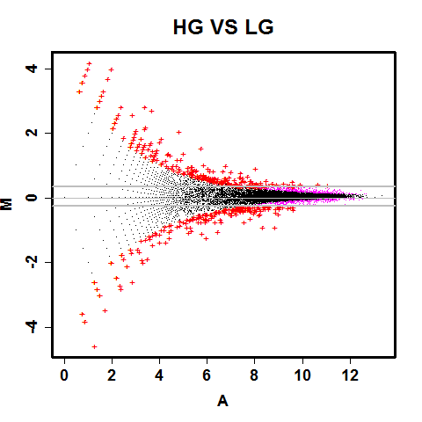
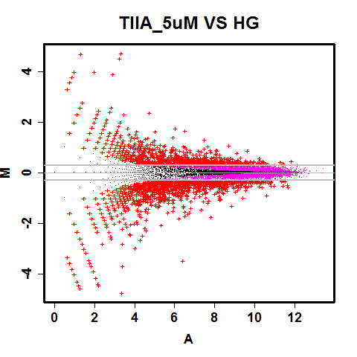
DEGseq normalization, log2 differences of at least 0.3 (1.23 fold-change)

Slide 11
Figure 2. DESeq2 FPM normalization, log2 differences of at least 0.3 (1.23 fold-change)
P-values from DEGseq
A
B
Figure 7. DESeq2 FPM normalization, log2 differences of at least 0.3 (1.23 fold-change)
P-values from DEGseq between HG/LG (A) and TIIA/HG (B)

Slide 12
Genes of interest | DNA Promoter methylation ratio of HG/LG | DNA Promoter methylation ratio of TIIA/HG | Fold change of expression in HG/LG from RNA-seq | Fold change of expression in TIIA/HG from RNA-seq
Fgl2 | -10.32419281 | 7.26531998 | 5.34555211 | 0.272532
Gulo/(GLO) | 18.5300207 | -14.5256917 | 0.121489821 | 3.997138
Kcnip2/KChIP2 | 11.567276 | -4.748313441 | 0.121489821 | 3.997138
Bmp8b | -1.188811189 | -12.27375566 | 0.2242889 | 5.995706

Slide 13
Genes of interest | DNA Promoter methylation ratio of HG/LG | DNA Promoter methylation ratio of TIIA/HG | Fold change of expression in HG/LG from RNA-seq | Fold change of expression in TIIA/HG from RNA-seq
Fgl2 | -10.324 | 7.265 | 5.346 | 0.273
Gulo/(GLO) | 18.530 | -14.526 | 0.121 | 3.997
Kcnip2/KChIP2 | 11.567 | -4.748 | 0.121 | 3.997
Nmu | -0.526 | 12.378 | 17.495 | 0.555

Slide 14
Fig 8. IPA pathway, disease and tox analysis

Slide 15
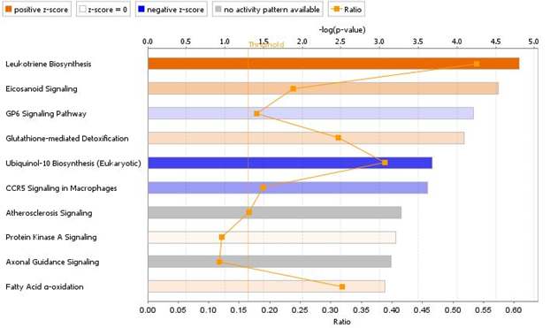
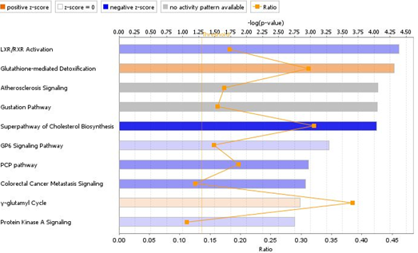
A
B
Canonical pathway HG/LG (left) and TIIA/HG(right)

Slide 16
Fig. 8 Canonical pathways identified by IPA for all significant and reliable Differentially expressed genes in HG versus LG (a) and TIIA versus HG (b) from mes-13 cells after 5 days treatment. Canonical
pathways are displayed as the –log(p-value) (upper) with the threshold of 1.5 indicating the minimum significance level. Length of the bars represents the significant associations. The ratio indicates the number of Differentially expressed genes in the comparison that map to a given canonical pathway divided by the total number of genes in that pathway.

Slide 17
Canonical Pathway:
Leukotriene Biosynthesis
Description:
Leukotrienes are proinflammatory metabolites of arachidonic acid that activate and amplify innate and adaptive immune responses. They also have roles in pathologic immune responses, mediating contraction of bronchial smooth muscles and chemoattraction of lymphocytes. The enzymes in this pathway are therefore targets for therapeutic intervention in allergic responses (20097252). Leukotriene B4 (LTB4) is a very potent chemoattractant, while LTC4 stimulates bronchial constriction in asthmatics. Enzymes in this biosynthetic pathway are also targets for cardiovascular therapies. Additional regulatory proteins are also candidate drug targets, such as the 5-lipoxygenase activating protein (FLAP), which has been linked to increased risk for myocardial infarction and stroke (14770184).
Biosynthesis Categories:
Hormones Biosynthesis
Top Functions & Diseases:
Skeletal and Muscular Disorders; Developmental Disorder; Endocrine System Disorders
Molecules:
show all
(5-L-glutamyl)-L-amino acid, (6E,8Z,11Z,14Z)-(5S)-5-hydroperoxyeicosa-6,8,11,14-tetraenoic acid, amino acids, arachidonate 5-lipoxygenase, arachidonic acid, DPEP, Ggt, glutathione, glycine, leukotriene A4, leukotriene B4, leukotriene C4, leukotriene D4, leukotriene E4, leukotriene-A4 hydrolase, leukotriene-C4 synthase

Slide 18
Canonical Pathway:
Eicosanoid Signaling
Description:
There are four types of eicosanoids: prostaglandins, lipoxins, leukotrienes and thromboxanes. Arachidonic acid (AA), the precursor for most eicosanoids, is produced by hydrolysis of membrane phospholipids by phospholipaseA2 (PLA2). AA is then converted to eicosanoids by one of two types of enzymes: 1) Prostaglandin endoperoxide synthases (PTGS), commonly referred to as cyclooxygenases (COX-1 and COX-2), catalyze the key step in the synthesis of biologically active prostaglandins, the conversion of arachidonic acid (AA) into prostaglandin H2 (PGH2). PGH2 serves as the precursor for thromboxanes, prostaglandins and prostacyclins.2) The lipoxygenases include ALOX5, ALOX12 and ALOX15. ALOX5 catalyzes the key step in the conversion of AA to leukotriene A4, B4 and C4. ALOX15 in concert with ALOX5 is involved in the formation of lipoxins A4 and B4.ALOX12 synthesizes 12(S)-HETE[12(S)-hydroxyeicosatetraenoic acid].
Eicosanoid receptors belong to the family of G-protein coupled receptors. Some of these receptors include BLT-1,-2 and CYSLTR1 and CYSLTR2 for leukotrienes, PTGERs for Prostaglandin E2, PTGFR for prostaglandin F2, PTGDR for prostaglandin D2 and TBXA2R for thromboxane A2. Eicosanoids transduce signals via their membrane receptors and mediate complex biological processes like inflammation, vascular permeability, allergic reactions, induction of labor and carcinogenesis.
Signaling Pathway Categories:
Intracellular and Second Messenger Signaling
Top Functions & Diseases:
Lipid Metabolism; Small Molecule Biochemistry; Cell Signaling
Molecules:
show all
12 lipoxygenase, 12-hydroxyeicosatetraenoic acid, 15(S)-HETE, 15-LOX, AKR1C3, Allergic asthma, ALOX5, ALOX5AP, Analgesia, Angiogenesis, arachidonic acid, Asthma, Chemotaxis, Chemotaxis of neutrophils, Closure of ductus arteriosus, Colon cancer, cyclooxygenase, Cysltr, dinoprost, DPEP, epoprostenol, Fever, FPR2, GGT1, hepoxilin, Homeostasis of water, Hyperalgesia, Inflammation, Inflammatory Diseases, leukotriene A4, leukotriene B4, leukotriene C4, leukotriene D4, leukotriene E4, lipoxin A4, lipoxin B4, LTA4H, LTB4R/LTB4R2, LTC4S, Neurotoxicity of neurons, Parturition, Permeability of blood vessel, PGDS/PTGDS, PGES, phospholipid, PLA2, Proliferation of cells, prostaglandin D2, prostaglandin E2, prostaglandin h2, PTGDR

Slide 19
LXR/RXR Activation
Description:
The retinoid X receptors (RXRs) are nuclear receptors that mediate the biological effects of retinoids by their involvement in retinoic acid-mediated gene activation. RXRα is the dimerization partner for the type II nuclear receptors that includes the liver X receptor (LXR). The LXR receptor is activated by oxysterol ligands and forms a heterodimer with RXR. After heterodimerization LXR initiates transcription of target genes by binding to the LXR response element. LXR/RXR is involved in the regulation of lipid metabolism, inflammation, and cholesterol to bile acid catabolism. Genes regulated by LXR include the ATP-binding cassette transporter A1 (ABCA1), which effluxes cholesterol from extrahepatic cells, the sterol regulatory element binding protein-1c (SREBP-1c), AIM and LPL. The "LXR/RXR Activation" list consists of the genes/proteins associated with LXR/RXR activation.
Top Functions & Diseases:
Lipid Metabolism; Small Molecule Biochemistry; Molecular Transport
Molecules:
show all
A1BG, ABCA1, ABCG1, ABCG4, ABCG5, ABCG8, ACACA, AGT, AHSG, ALB, AMBP, APOA1, APOA2, APOA4, APOA5, APOB, APOC1, APOC2, APOC3, APOC4, APOD, APOE, APOF, APOH, APOL1, APOM, ARG2, C3, C4A/C4B, C9, CCL2, CCL7, CD14, CD36, CETP, CLU, CYP51A1, CYP7A1, ECHS1, FASN, FDFT1, FGA, GC, HADH, HMGCR, HPR, HPX, IL18, IL18RAP, IL1A, IL1B

Slide 20
Glutathione-mediated Detoxification
Description:
Please note: This is a general detoxification pathway, where the first step can be catalyzed by many different enzymes, collectively known as glutathione transferases, or GSTs. In the first reaction, R may be an aliphatic, aromatic or heterocyclic group, and X may be a sulfate, nitrile or halide group.
General Background Thiols play several major roles in the cell; they help maintain the redox balance, keeping a reduced environment (see the pathway glutathione redox reactions II), they fight reactive oxygen and nitrogen species (ROS and NOS, respectively), and they are involved in the detoxification of many other toxins and stress-inducing factors. In most organisms the major thiol is the tripeptide glutathione (γ-Glu-Cys-Gly, known as GSH). GSH is active against toxins by a process that involves multiple enzymes, and in the case of eukaryotes, occurs across multiple organs.
About This Pathway In this important detoxification mechanism GSH binds to electrophilic chemicals, forming conjugates which are exported from the cell. These conjugation reactions have been demonstrated for a multitude of foreign chemicals, as well as endogenous reactive intermediates. GSH has been shown to form thioether conjugates with leukotrienes, prostaglandin, hepoxilin, nitric oxide, hydroxyalkenals, L-ascorbate, L-dopa, dopamine, and maleate, and it forms thioesters with L-cysteine, coenzyme A, proteins, and other cellular thiols. In addition, GSH also binds endogenous metals, such as copper, selenium, chromium, and zinc, via nonenzymatic reactions. The first step is catalyzed by glutathione S-transferase, a family of enzymes found mainly in the cytosol. Once formed, the GSH-toxin conjugates are metabolized by the same degradative enzymes that metabolize GSH (see γ-glutamyl cycle). The GSH-toxin conjugate is transported out of the cell, where it is subsequently degraded by Gamma-glutamyl hydrolase or γ-glutamyl transpeptidase, and dipeptidases. The breakdown products of the GSH-toxin conjugates (glutamate and glycine) are reabsorbed and can be used for GSH synthesis. The L-cysteine-S-conjugate that is left is also transported back into the cell, where it can be metabolized in different ways. One route is the acetylation of the amino group of the cysteinyl residue by intracellular N-acetyltransferases to form the corresponding mercapturic acids (N-acetylcysteine S-conjugates). The addition of the N-acetylcysteine moiety generally increases the compound's polarity and water solubility, and converts neutral compounds to anions, facilitating their transport across cell membranes and their excretion from the organism. Mercapturic acids are released into the circulation or bile [ 1939239] ; some are eventually excreted in urine, and some may undergo further metabolism. A second route for L-cysteine-S-conjugate is the breakage of the carbon-sulfur bond, catalyzed by S-alkylcysteine lyase resulting in the formation of thiols, pyruvate and ammonia. This enzymatic activity has been shown in both eukaryotes and prokaryotes. The thiols which are produced in this reaction are most likely oxidized to sulfonates, or methylated to methylsulfinyl or methylsulfonyl derivatives. Yet additional fates for L-cysteine-S-conjugate are possible. It has been shown that these compounds can be substrates for other enzymes, including aminotransferase and L-amino acid oxidase. While this pathway has been studied in detail in eukaryotes, considerably less in known about bacteria. Recent sequencing projects of bacterial genomes have revealed the presence of numerous glutathione S-transferase genes in many microbes. Biochemical evidence for the activity of such enzymes is also abundant. It seems that bacteria are more likely to continue by the cysteine conjugate lyase route, as there are several reports for this activity in bacteria.

Slide 21
Tox List Report:
FXR/RXR Activation
Description:
The farnesoid X receptor (FXR) is a member of the nuclear family of receptors and has emerged as a key player in the control of numerous metabolic pathways. Bile acids and their intermediates activate FXR, which thus serves as a sensor of bile acid levels. Along with retinoid X receptor (RXR), FXR plays a crucial role in linking bile acid regulation with lipoprotein, lipid and glucose metabolism. The concentration of bile acids and their intermediates can be elevated in conditions like cholestasis or inborn metabolic disorders. The metabolic syndrome is characterized by insulin resistance and glucose tolerance, abdominal obesity, hypertension, low high-density lipoproteins (HDL) and hypertriglyceridemia. As a modulator of bile, lipid and glucose homeostasis, FXR is an interesting pharmacological target for therapeutic applications. The "FXR/RXR Activation" list and corresponding pathway consist of genes/proteins associated with activation of the FXR/RXR heterodimer.
Top Functions & Diseases:
Lipid Metabolism; Small Molecule Biochemistry; Molecular Transport
Molecules:
show all
A1BG, ABCB11, ABCB4, ABCC2, ABCG5, ABCG8, AGT, AHSG, AKT1, AKT2, AKT3, ALB, AMBP, APOA1, APOA2, APOA4, APOB, APOC1, APOC2, APOC3, APOC4, APOD, APOE, APOF, APOH, APOL1, APOM, BAAT, C3, C4A/C4B, C9, CETP, CLU, CREBBP, CYP19A1, CYP27A1, CYP7A1, CYP8B1, FABP6, FASN, FBP1, FETUB, FGA, FGF19, FGFR4, FOXA1, FOXA2, FOXA3, FOXO1, G6PC, G6PC2

Slide 22
Canonical Pathway:
GP6 Signaling Pathway
Description:
GPVI is a member of the immunoglobulin superfamily and is expressed in platelets and their precursor megakaryocytes. It serves as the major signaling receptor for collagen, which induces platelet activation and thrombus formation. GPVI can also be activated by laminin, fibrin, collagen-related peptide (CRP), convulxin, alborhagin and by low shear stress. The extracellular region of GPVI contains two Ig-like domains, which are responsible for collagen binding, and a short mucin-like Ser/Thr-rich stalk. GPVI is expressed on platelets in a mixture of monomeric and dimeric forms. The affinity of collagen for monomeric GPVI is too low to mediate activation, and dimeric GPVI is the active form with increased affinity.
Platelets abundantly express sheddases of the metalloproteinase (ADAM) family, which is used to regulate the function of adhesion and signaling receptors. The sheddase responsible for GPVI proteolysis is ADAM10. The association of calmodulin with GPVI inhibits the activation of ADAM10, and is regulated by calcium signaling, which plays a key role in overall platelet activation.
On the platelet plasma membrane, GPVI forms a complex with the homodimeric FcR-gamma. Each FcR-gamma chain contains one copy of an immunoreceptor tyrosine-based activation motif (ITAM) with two Tyr residues. Src family protein kinases Fyn and Lyn phosphorylate the ITAM Tyr residues which triggers GPVl-mediated signaling.
Phosphorylated FcR-gamma activates tyrosine kinase Syk, which leads to a cascade of protein phosphorylation events, phosphorylating the transmembrane adapter protein LAT, cytosolic adapter protein SLP76 and GADs and other adaptor and effector proteins, which together form LAT signalosome. The recruitment and phosphorylation of these proteins leads to the activation of phospholipase PLC-gamma-2 which cleaves phosphatidylinositol 4,5-diphosphate (PIP2) into the second messengers 1,2-diacylglycerol (DG) and inositol 1,4,5-trisphosphate (IP3). IP3 binds to receptors in plasma and intracellular membranes, leading to the release of Ca2+, while DG is the activator molecule for protein kinase C (PKC). The accumulated Ca2+ and PKC contribute to integrin-mediated platelet activation, which induce thrombus formation.
The phosphoinositide 3-kinase (PI3K) phosphorylates PIP2, converting it into phosphatidylinositol 3,4,5-triphosphate (PIP3), which leads to platelet activation via Akt signaling and also supports the recruitment of the tyrosine kinase BTK to the membrane, which undergoes autophosphorylation subsequent to phosphorylation by Lyn. BTK is responsible for PLC-gamma-2 phosphorylation and protein tyrosine kinase 2 (PTK2) activation. PTK2 activation leads to dense granule secretion and also has an important role in platelet activation via intracellular ROS accumulation.
Signaling Pathway Categories:
Cellular Stress and Injury
Top Functions & Diseases:
Cell-To-Cell Signaling and Interaction; Hematological System Development and Function; Inflammatory Response
Molecules:
show all
1,2-diacylglycerol, 1,4,5-IP3, 1-phosphatidyl-D-myo-inositol 4,5-bisphosphate, Accumulation of reactive oxygen species, Activation of blood platelets, ADAM10, Akt, Alborhagin, APBB1IP, BTK, Ca2+, Calmodulin, collagen, collagen-related peptide, FCER1G, Fcer1g dimer, Fibrin, Formation of lamellipodia, FYN, GP6, GP6 dimer, GP6 FCR1G complex, GPIIB-IIIA, GRAP2, Gsk3, ITPR1, Laminin (family), LAT, LAT signalosome, LCP2, LYN, NOX1, Pdpk, phosphatidylinositol-3,4,5-triphosphate, PI3K (complex), Pkc(s), PLCG2, PRKCD, PTK2, RAC1, RAP1B, RASGRP2, RHOG, SCHIP1, Secretion of dense granule, SYK, TLN1

Slide 23
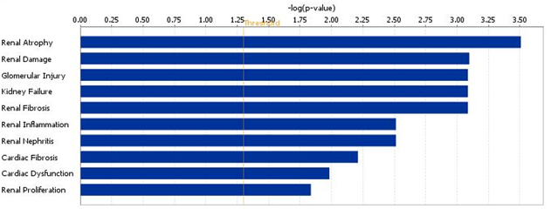
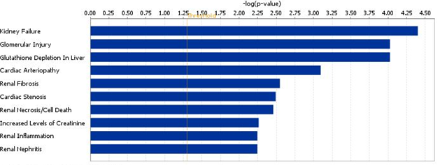
Figure 9. The 10 most associated tox results related to HG versus LG (upper) and TIIA versus HG(lower)

Slide 24
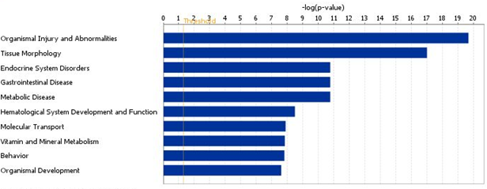
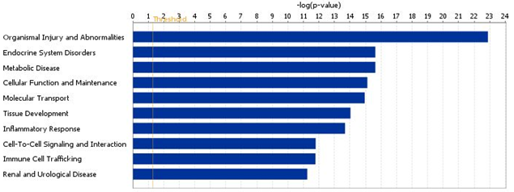
Figure X. The 10 most associated disease related to HG versus LG (upper) and TIIA versus HG(lower)

Slide 25
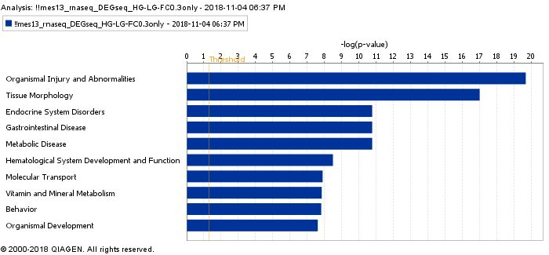
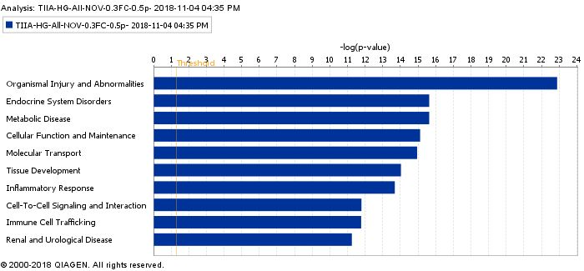
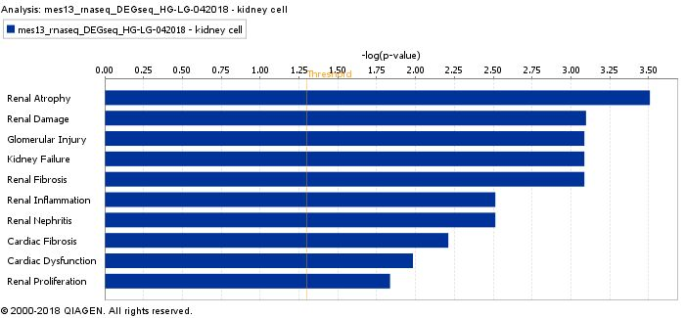
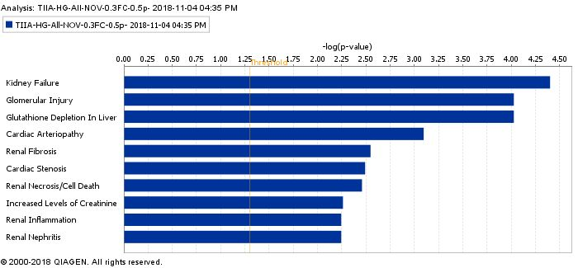
HG-LG
Disease & TOX HG/LG (left) and TIIA/HG(right)

Slide 26
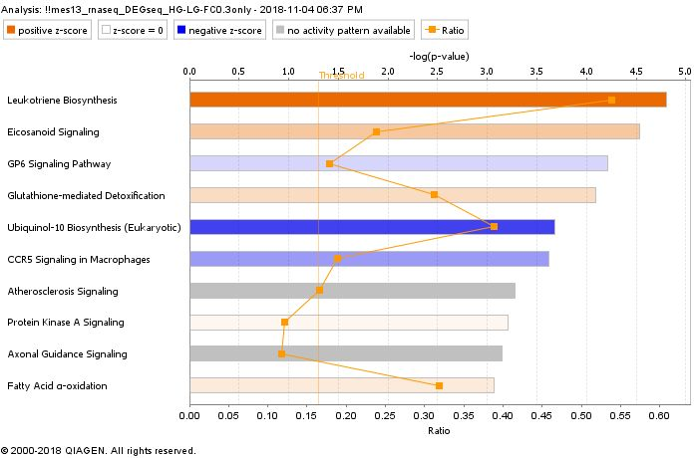
HG-LG

Slide 27
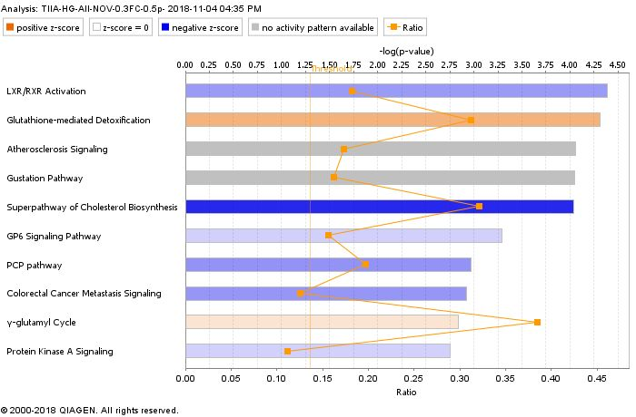

Slide 29
End for formal figures

Slide 30
Synonym(s):
neuromedin U, NMU-23, NMU25, Nmu-r1
NCBI CDD Domains (Superfamilies / Multi-Domains):
Neuromedin U
role in cell:
synaptic transmission, elevation in, size, quantity, formation, activation, activation in, degranulation, expression in, phosphorylation
disease:
obesity, hepatic steatosis, hyperglycemia, hyperphagia, edema, invasive breast cancer, breast carcinoma, invasive breast carcinoma, endometrial adenocarcinoma formation, endometrial adenocarcinoma, epithelial thyroid cancer, thyroid carcinoma, rectum cancer, colorectal carcinomagenesis, rectal adenocarcinoma, squamous cell lung cancer, lung squamous cell carcinoma, lung adenocarcinoma formation, lung adenocarcinoma, colon epithelial cancer, colon adenocarcinoma, transitional cell bladder cancer, urothelial bladder carcinoma, arthritis, uterine serous papillary cancer, hypophagia, hyperinsulinism, hyperleptinemia, hyperlipidemia
NMU These results suggested that NMU can act directly on β cells through NMUR1 in an autocrine or paracrine fashion to suppress insulin secretion.
Neuromedin U suppresses glucose-stimulated insulin secretion in pancreatic β cells ???

Slide 31
Entrez Gene Name:
bone morphogenetic protein 8b
Synonym(s):
bone morphogenetic protein 8b, Op3
role in cell:
abnormal morphology, number, lack, apoptosis, development, morphology, quantity, differentiation, proliferation
disease:
growth failure, developmental delay, hyperplasia
Loss of BMP8B substantially increases susceptibility to diet-induced obesity

Slide 32
Entrez Gene Name:
fibrinogen like 2
Synonym(s):
AI385601, fibrinogen-like 2, fibrinogen-like protein 2, FIBROLEUKIN, musfiblp, PCA protein (70 kDa), pT49, T49
role in cell:
degranulation, production in, necrosis, cellular infiltration by, proliferation, apoptosis
disease:
uterine serous papillary cancer, systemic juvenile idiopathic arthritis
Fgl2 Fibrinogen-like protein 2 expression correlates with microthrombosis in rats with type 2 diabetic nephropathy

Slide 33
Entrez Gene Name:
gulonolactone (L-) oxidase
Synonym(s):
5730581M22, AU018375, BC028822, D-Arabino-1,4-lactone oxidase (GULO) similar, GLO, gulonolactone (L-) oxidase, LGO, L-gulono-gamma-lactone oxidase, L-Gulonolactone oxidase, L-gulono-γ-lactone oxidase, LOC100505222, sfx, unh, unhip
role in cell:
number, expression in, proliferation
disease:
weight loss, growth failure, anemia, bleeding, desquamation
the activity of L-gulono-gamma-lactone oxidase (GLO), a terminal enzyme of AA biosynthesis [14], is impaired in diabetic animals and decreased GLO activity impairs the ability to synthesize AA [15].
Impaired ascorbic acid metabolism in streptozotocin-induced diabetic rats

Slide 34
Entrez Gene Name:
potassium voltage-gated channel interacting protein 2
Synonym(s):
AI851528, KCHIP2, Kv channel-interacting protein 2, Kv channel-interacting protein 2-like, LOC100911951, potassium voltage-gated channel interacting protein 2
role in cell:
function, excitability
disease:
systemic lupus erythematosus, arrhythmia, seizures, Huntington disease
Kcnip2/KChIP2 Type 2 diabetes induces subendocardium-predominant reduction in transient outward K+ current with downregulation of Kv4.2 and KChIP2

Slide 35
Synonym(s):
neuromedin U, NMU-23, NMU25, Nmu-r1
NCBI CDD Domains (Superfamilies / Multi-Domains):
Neuromedin U
role in cell:
synaptic transmission, elevation in, size, quantity, formation, activation, activation in, degranulation, expression in, phosphorylation
disease:
obesity, hepatic steatosis, hyperglycemia, hyperphagia, edema, invasive breast cancer, breast carcinoma, invasive breast carcinoma, endometrial adenocarcinoma formation, endometrial adenocarcinoma, epithelial thyroid cancer, thyroid carcinoma, rectum cancer, colorectal carcinomagenesis, rectal adenocarcinoma, squamous cell lung cancer, lung squamous cell carcinoma, lung adenocarcinoma formation, lung adenocarcinoma, colon epithelial cancer, colon adenocarcinoma, transitional cell bladder cancer, urothelial bladder carcinoma, arthritis, uterine serous papillary cancer, hypophagia, hyperinsulinism, hyperleptinemia, hyperlipidemia
NMU These results suggested that NMU can act directly on β cells through NMUR1 in an autocrine or paracrine fashion to suppress insulin secretion.
Neuromedin U suppresses glucose-stimulated insulin secretion in pancreatic β cells ???

Slide 36
IPA analysis
1. Kidney cell, non-specific cell lines, cut-off (-0.3, 0.3)

Slide 38
TOX functions
HG-LG
HG-TIIA-5uM

Slide 41
IPA analysis

